Slide 1


Real-Time Ordering (RTO) integration with OASIS platform
Yoel Kortick
Senior Librarian
http://www.slideteam.net/wp/wp-content/uploads/2015/11/Using-Images-and-Icons-to-Create-Awesome-Agenda-Slides.1.png

Slide 2

Agenda
Introduction
Creating a new order via OASIS
The order gets created in Alma
View previous orders in OASIS
The setup in Alma
text6

Slide 3
Introduction
This presentation will show the workflow for Alma Real-Time Ordering (RTO) integration with the OASIS platform.
As part of this workflow an order is created by the user in the OASIS platform and in real time also created in Alma.
Bibliographic as well as acquisition information such as the fund, price, and library information is taken from OASIS and used to create the record in Alma.

Slide 4
Introduction
The advantage of using the Real Time Ordering in this manner is to achieve a faster and more efficient workflow
A faster process: The order is created automatically in Alma this there is no need for double entering of data. This ensures data integrity preventing possible human errors in the double entering of data.
A streamlined process: Because the actions are done behind the scenes via an API there is no need to set up import profiles and use MARC EOD files and an ftp server.

Slide 5
Agenda
Introduction
Creating a new order via OASIS
The order gets created in Alma
View previous orders in OASIS
The setup in Alma
text6

Slide 6
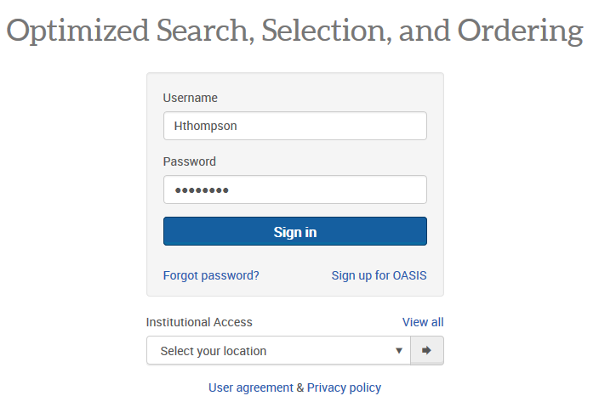
Creating a new order via OASIS
Login to the OASIS Platform as follows

Slide 7
Creating a new order via OASIS
The OASIS landing page has
Quick search and advanced search
Ability to quickly and easily select your own preferences

Slide 8
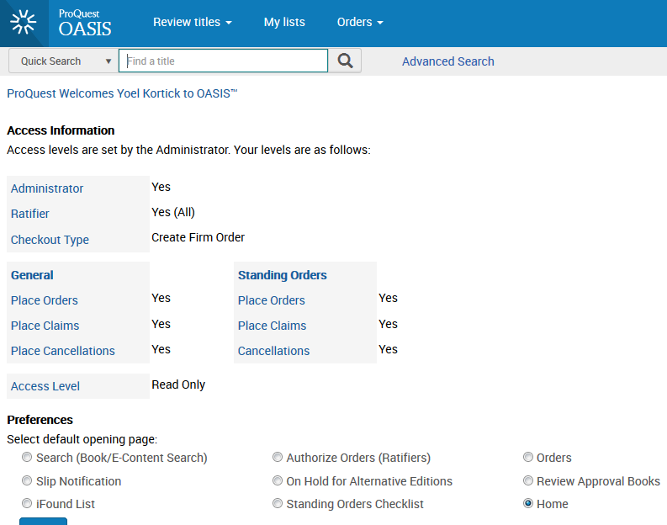
Creating a new order via OASIS

Slide 9
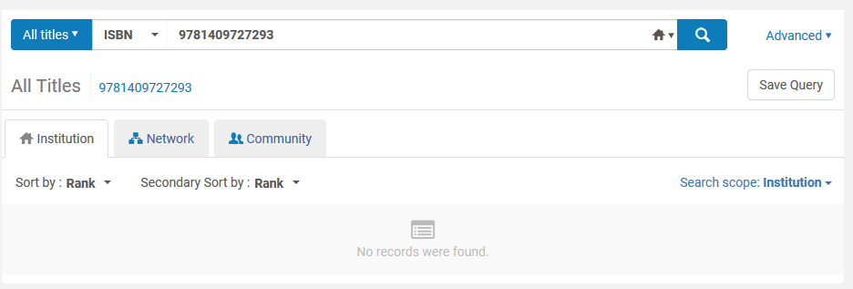
Creating a new order via OASIS
We will perform a search for something that does not yet exist in Alma.
We will search for ISBN 9781409727293 and it does not yet exist in Alma
Here we see that in Alma it does not yet exist
This is Alma and we see that ISBN 9781409727293 is not (currently) in the Alma repository
This record does not exist in Alma

Slide 10
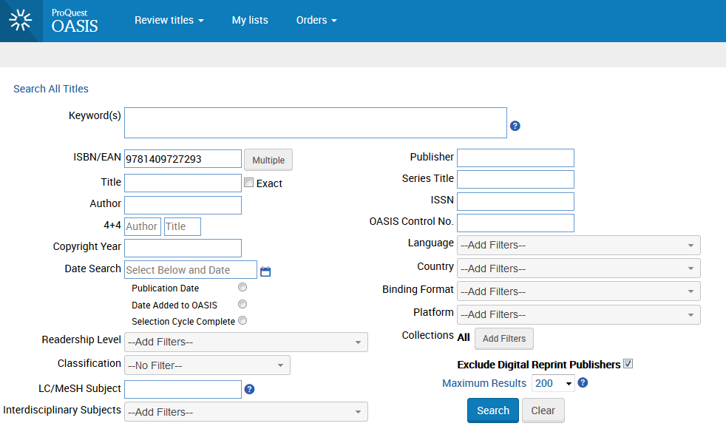
Creating a new order via OASIS
Now we search for the same ISBN in OASIS

Slide 11
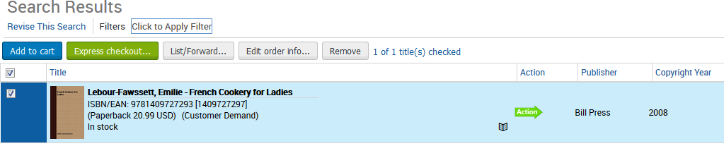
Creating a new order via OASIS
Select the record and click ‘Edit Order Info’

Slide 12
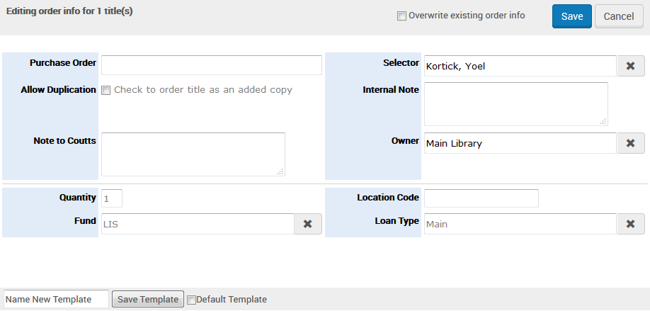
Creating a new order via OASIS
We choose Library ‘Main Library’, Fund ‘LIS’ and Quantity ‘1’
It is possible to choose there values as a template
We will click ‘Save’ on top right
Fund code in Alma
Library in Alma
If desired could save this information as a temple for the future

Slide 13
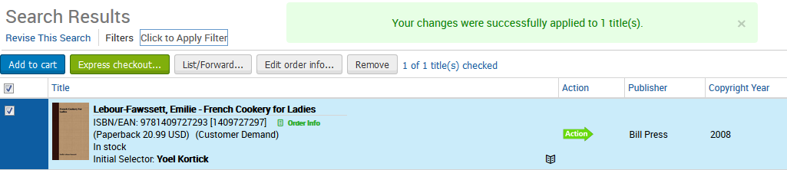
Creating a new order via OASIS
Get message that your changes were applied
There is now a have link to ‘order info’ Click ‘Express Checkout’
Here we see that the price is 20.00 USD and we will later see it in Alma
Price

Slide 14

Creating a new order via OASIS
After clicking ‘Express Checkout’ the following screen appears and we select “Order all” and click ‘Submit all’
Now the API is ‘talking to’ Alma and creating the order and the bibliographic record

Slide 15
Agenda
Introduction
Creating a new order via OASIS
The order gets created in Alma
View previous orders in OASIS
The setup in Alma
text6

Slide 16
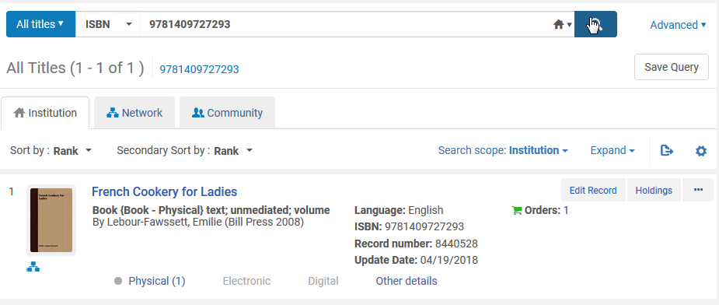
The order gets created in Alma
Now we can see the bibliographic record and order which was created in Alma from OASIS .
Previously a search in Alma on this ISBN gave no results
This is the record we ordered in Alma just a moment ago
The order was created

Slide 17
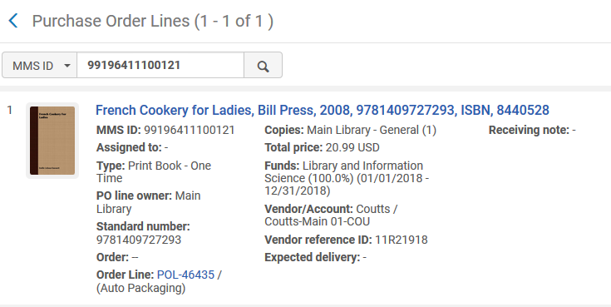
The order gets created in Alma
Here is the order in Alma
Price information from OASIS
Library and fund is what we entered in OASIS

Slide 18
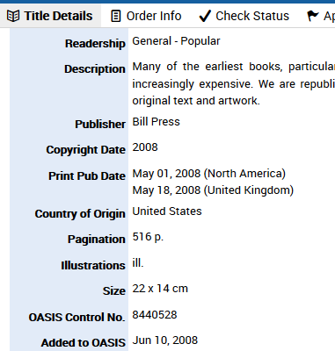
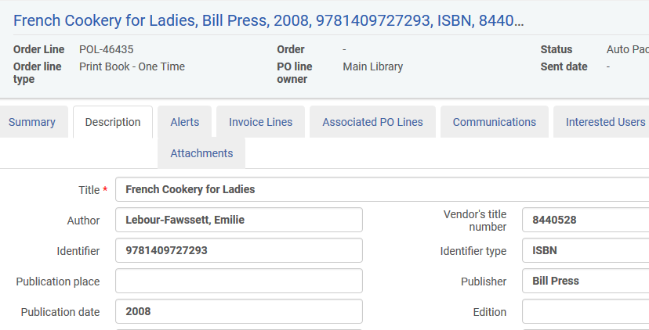
The order gets created in Alma
The OASIS control number is added to Alma order “Vendor Title Number” field
OASIS
Alma

Slide 19
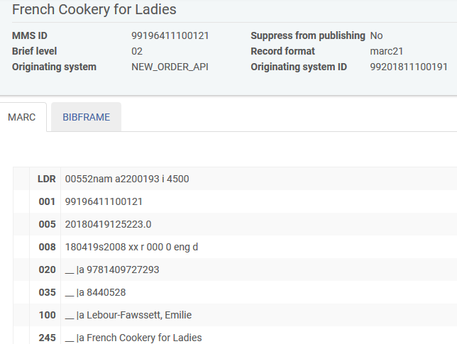
The order gets created in Alma
The bibliographic record created in Alma has an originating system “NEW_ORDER_API”

Slide 20
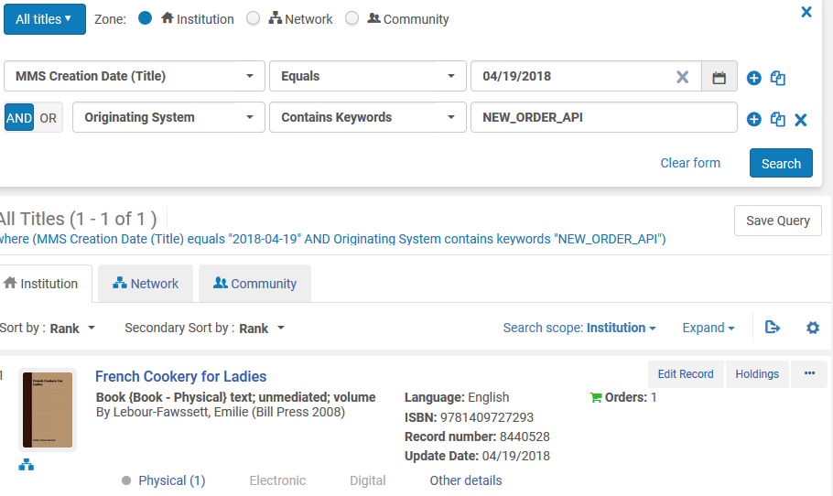
The order gets created in Alma
In this manner it is possible to retrieve all records created from the OASIS system with additional parameters such as creation date

Slide 21
Agenda
Introduction
Creating a new order via OASIS
The order gets created in Alma
View previous orders in OASIS
The setup in Alma
text6

Slide 22
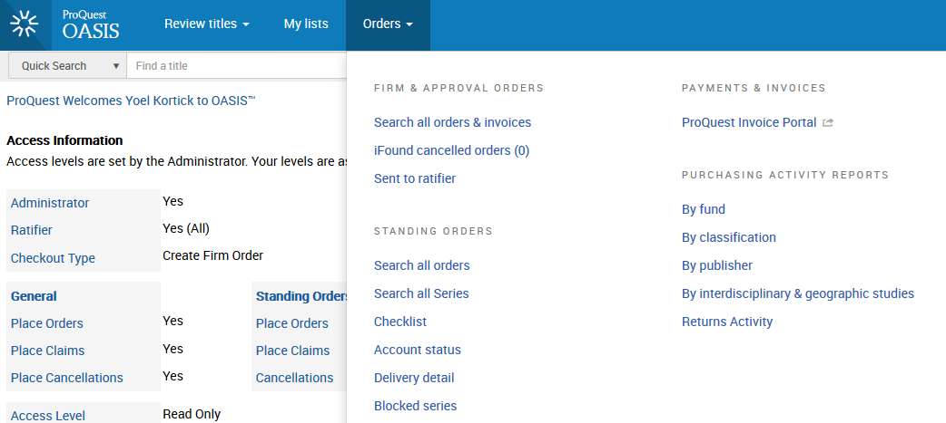
View previous orders in OASIS
If desired you can view your previous orders

Slide 23
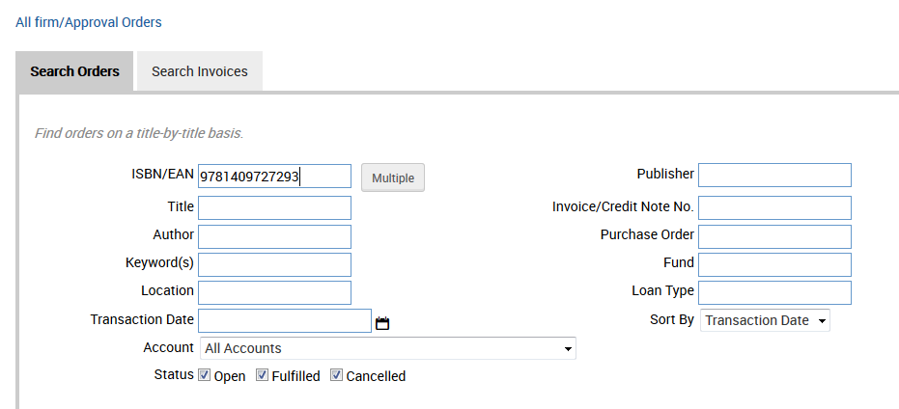
View previous orders in OASIS
We will search for the order we previously made
This is the ISBN we previously ordered

Slide 24
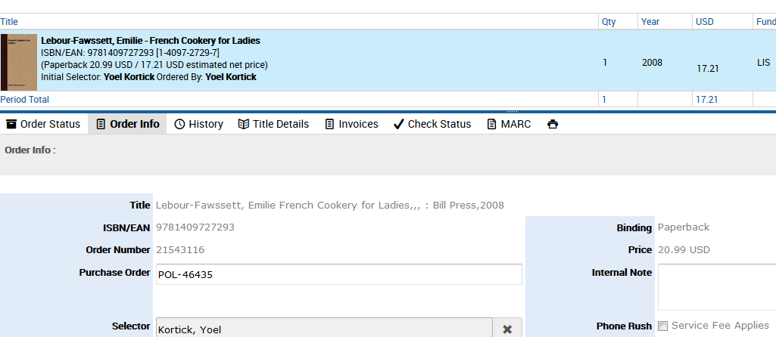
View previous orders in OASIS
From results view the order information
Note that the POL Number from Alma is in the OASIS record
The Purchase order number in Alma gets updated in the OASIS order information. The API works in both directions.

Slide 25
Agenda
Introduction
Creating a new order via OASIS
The order gets created in Alma
View previous orders in OASIS
The setup in Alma
text6

Slide 26
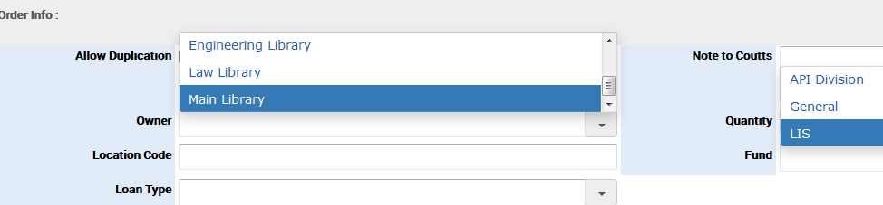
The setup in Alma
Once you have given your vendor, fund, and library / location codes(s) to OASIS, they will be part of your profile when you log into OASIS
For example here are predefined lists for Owning library and fund:
Library in Alma
Fund code in Alma

Slide 27
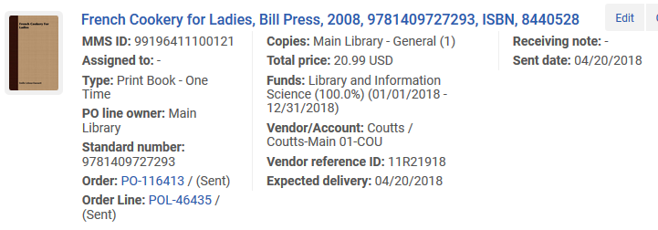
The setup in Alma
Then when the order gets created in Alma those values are used in the order
Price information from OASIS
Library and fund is what we entered in OASIS

Slide 28
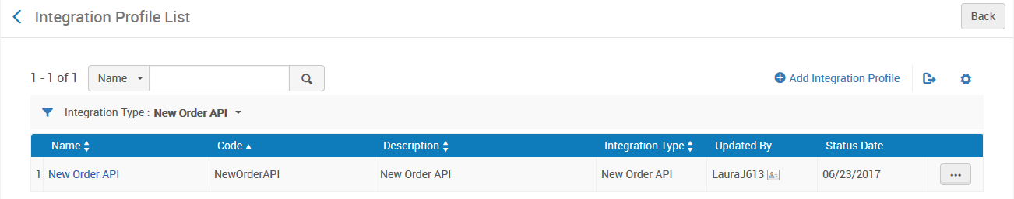
The setup in Alma
To further control how the order gets created in Alma you should define the integration profile of type ‘New Order API’.

Slide 29
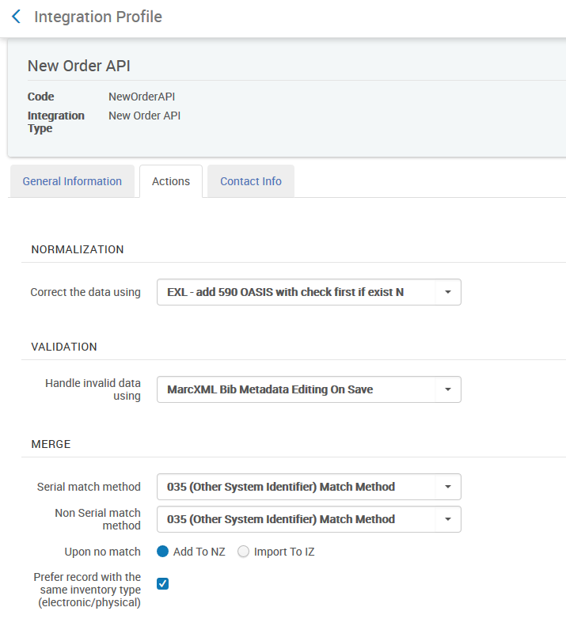
The setup in Alma
To further control how the order gets created in Alma you can define the integration profile of type ‘New Order API’.

Slide 30
The setup in Alma
For additional information regarding parameters needed by the OASIS interface contact Roger.Jette@proquest.com
For additional information configuring the integration profile of type ‘New Order API’ see:
Create PO line API: How the bibliographic record is determined? https://developers.exlibrisgroup.com/blog/Create-PO-line-API-how-the-bibliographic-record-is-determined
Real Time Ordering: https://knowledge.exlibrisgroup.com/Alma/Product_Documentation/Alma_Online_Help_(English)/Acquisitions/020Purchasing/020Creating_PO_Lines/020Real-Time_Acquisitions
External Systems” https://knowledge.exlibrisgroup.com/Alma/Product_Documentation/Alma_Online_Help_(English)/Administration/050Configuring_General_Alma_Functions/050External_Systems

Slide 31
Thank You

